Slide 1
Emergency Communication Scenario with Privacy Safeguards
Project Presentation
Presented by: Dacena Martin
Notes:
Hello, my name is Dacena Martin. Today, I am presenting my CYSE 587 course project titled Emergency Communication Scenario with Privacy Safeguards. This simulation focuses on protecting sensitive information in real time communication between victims and emergency response units using secure MQTT messaging.

Slide 2
Problem Description
Victims need to send emergency help messages securely.
Drones act as MQTT brokers in the communication flow.
Messages carry sensitive identity and location details.
Risk of exposure and interception is high.
Objective: Ensure message privacy without breaking real-time flow.
Notes:
In a disaster or emergency situation, victims must be able to send help messages that include their location or identity. These messages are transmitted via MQTT, with drones acting as brokers. However, MQTT doesn’t secure data by default and this can lead to privacy risks if someone intercepts the message.
My goal in this project was to implement a communication model that keeps messages secure and private while ensuring they still reach the Command and Control unit in real time.

Slide 3
Privacy Threat Analysis (LINDDUN Framework)
Linkability - Messages from the same victim can be linked.
Identifiability - Real identity may be revealed.
Non-repudiation - Victims can’t deny sending messages.
Detectability - Message flow reveals victim activity.
Disclosure - Location/help info might leak.
Unawareness - Victims may not know what's being shared.
Non-compliance - Risk of breaking privacy laws.
Notes:
To identify privacy risks, I used the LINDDUN framework which focuses on threats specific to privacy.
For example, if a victim sends multiple messages, someone could link them together, that’s a linkability threat.
If a name or identifier is in the message, it could reveal who the person is, that’s identifiability.
There is also a risk that victims could be permanently tied to the data they send, known as non-repudiation.
Even if messages are encrypted, someone could still detect when they were sent, which reveals behavior.
And most importantly, without proper protections, this system could end up violating privacy laws.
That’s why I planned my design around these risks from the beginning.

Slide 4
Why MQTT Needs Extra Privacy Safeguards
Wildcard topics can expose message patterns.
Payloads are unencrypted by default.
No built-in anonymity.
Message frequency reveals user activity.
Metadata exposure is possible.
Notes:
While MQTT is great for lightweight messaging, it is not built with privacy in mind.
For instance, someone could use wildcard subscriptions like # to listen to everything published on the network.
Also, unless we explicitly encrypt the payload, messages are in plain text, that’s a big risk.
MQTT doesn’t have native support for anonymity, so if we use real names or IDs, they’re exposed.
Even if we hide the message content, just the timing and frequency of messages can give clues about user behavior.
So it became clear that MQTT needed some added protections for our emergency system.

Slide 5
Privacy Enhancements I Used
Two Key Privacy Enhancements Applied
Tokenization: Replaced names with random UUIDs
Encryption: Secured payload using Fernet
Ensured anonymity and confidentiality
Minimal performance impact
Easy to integrate with MQTT
Notes:
To address the risks, I added two strong privacy safeguards to my MQTT setup.
First, I used Tokenization, instead of real names or IDs, I generated unique UUIDs for each message. This makes it impossible to directly trace a message back to a specific victim.
Second, I applied Encryption using Python’s Fernet module. This means even if someone grabs a message, they won’t be able to read anything without the key.
Together, these two PETs, tokenization and encryption, ensured privacy without slowing things down.
It was easy to plug them into the MQTT message flow and they worked really well in protecting both identity and content.

Slide 6
Before vs. After Privacy Protections
Aspect | Without PETs | With PETs
Victim Identifier | Plain names | Randomized tokens
Message Visibility | Fully readable text | Strongly encrypted with no readable data
Risk of Data Exposure | Extremely high | Significantly reduced
Legal Compliance | Potential privacy violations | Aligned with standard privacy principles
Notes:
Here is a simple comparison that highlights how much privacy improved after applying the PETs.
At first, messages included plain names and readable content, which made them easy targets for attackers.
After I applied tokenization and encryption, names were replaced with random tokens and message content was completely protected.
Even if intercepted, the data is now meaningless without the decryption key.
This transformation not only enhances security but also brings the system in line with data privacy standards like GDPR.

Slide 7
Demo and Implementation Overview
System Setup and Privacy Implementation
Used Mosquitto MQTT broker on localhost
Publisher: securePublisher.py sends tokenized, encrypted messages
Subscriber: secureSubscriber.py decrypts and displays messages
Applied Fernet encryption + UUID tokenization
Encrypted key securely stored in keys/secureKey.key
Notes:
Let me now walk you through how I built and tested this system.
I installed the Mosquitto MQTT broker locally and used it as the central message broker.
For the publisher, I wrote a script named securePublisher.py that simulates victims by sending randomly generated UUID tokens along with location data.
The payloads are encrypted using Fernet, a strong symmetric encryption method.
The subscriber script, secureSubscriber.py, listens on the same topic and decrypts the messages using the shared key.
I stored that key safely inside a keys/secureKey.key file, making sure only the authorized receiver can access it.
This structure keeps the communication fast, simple and secure.

Slide 8
Live Demo Snapshots
Publisher sends 10 tokenized and encrypted messages
Subscriber decrypts and displays each message securely
Output shows UUID tokens and random coordinates
Encryption adds uniform message size and prevents leakage Output screenshots are included in next slide..

Slide 9
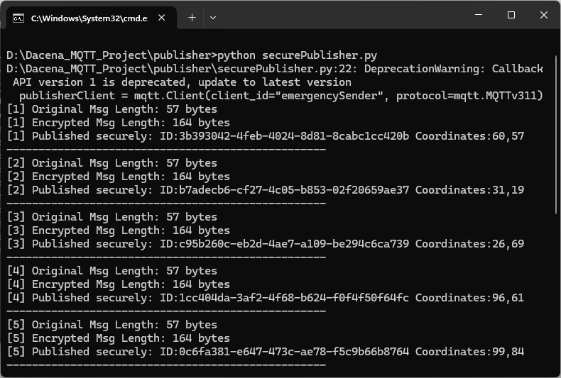
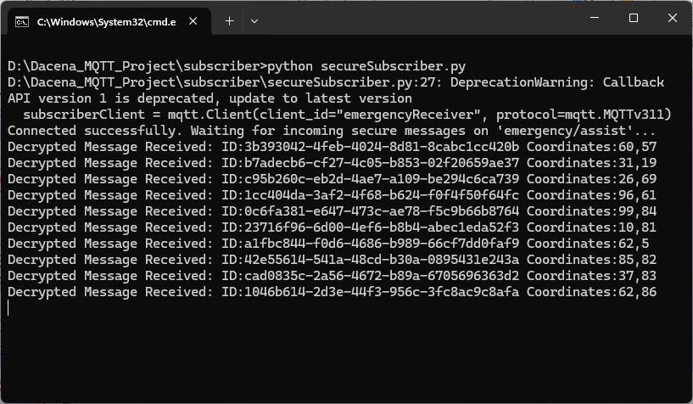
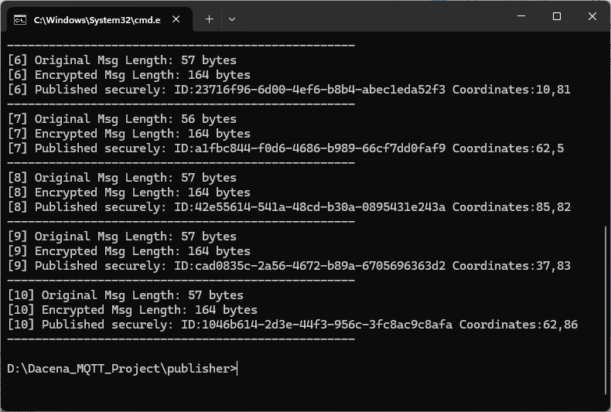
Output screenshots
Notes:
Here we can see the actual terminal outputs.
On the left is the publisher it shows the original message size and its encrypted version. Each message includes a randomized UUID and dynamic coordinates.
Notice that all encrypted messages are uniformly 164 bytes, regardless of content, this helps defend against pattern analysis.
On the right, the subscriber receives and decrypts those messages. It prints the original content, proving that the encryption and decryption flow is working as intended.
This confirms that privacy is preserved during real-time message transmission, without affecting system performance.

Slide 10
Evaluation & Trade-Offs
Privacy Controls: Evaluation and Trade-Offs
Message size increased: from 57 bytes to 164 bytes
System performance remained smooth and real-time
Victim anonymity ensured through UUID tokens
End-to-end encryption protected message content
Slight complexity added but privacy gains justified
Notes:
To evaluate the effectiveness of my privacy protections, I compared several aspects of the system before and after applying them.
Encrypted messages increased in size from around 57 bytes to 164 bytes due to the Fernet encryption layer. However, this did not impact performance, messages were still delivered in real time with no noticeable delay.
Tokenization using UUIDs completely removed any direct link to real names, providing strong anonymity. And because the entire message payload was encrypted, even if someone intercepted it, they’d see only gibberish.
The system did become slightly more complex due to the key management and encryption setup, but the privacy improvements far outweigh that trade-off.
Overall, both protections worked together to improve the system’s privacy without sacrificing usability or speed.

Slide 11
Reflections and Conclusion
My Final Reflections
Privacy must be a priority even in emergencies
LINDDUN helped uncover real-world threats
Tokenization and encryption were simple yet effective
Built a secure system without sacrificing usability
Notes:
During this project, I realized how crucial privacy is, even during disasters. Just because it’s an emergency doesn’t mean sensitive information should be exposed.
Using the LINDDUN framework helped me systematically identify real threats in a simple MQTT messaging setup.
By applying just two practical techniques tokenization and encryption, I was able to protect both victim identity and message content effectively.
The system remained fast and responsive, proving that security doesn’t have to come at the cost of performance.
This project taught me how to apply privacy-by-design principles in real-time systems and I am confident the same can be extended to even larger, more complex setups.
Thank you.

Slide 12
Thankyou

